Slide 1

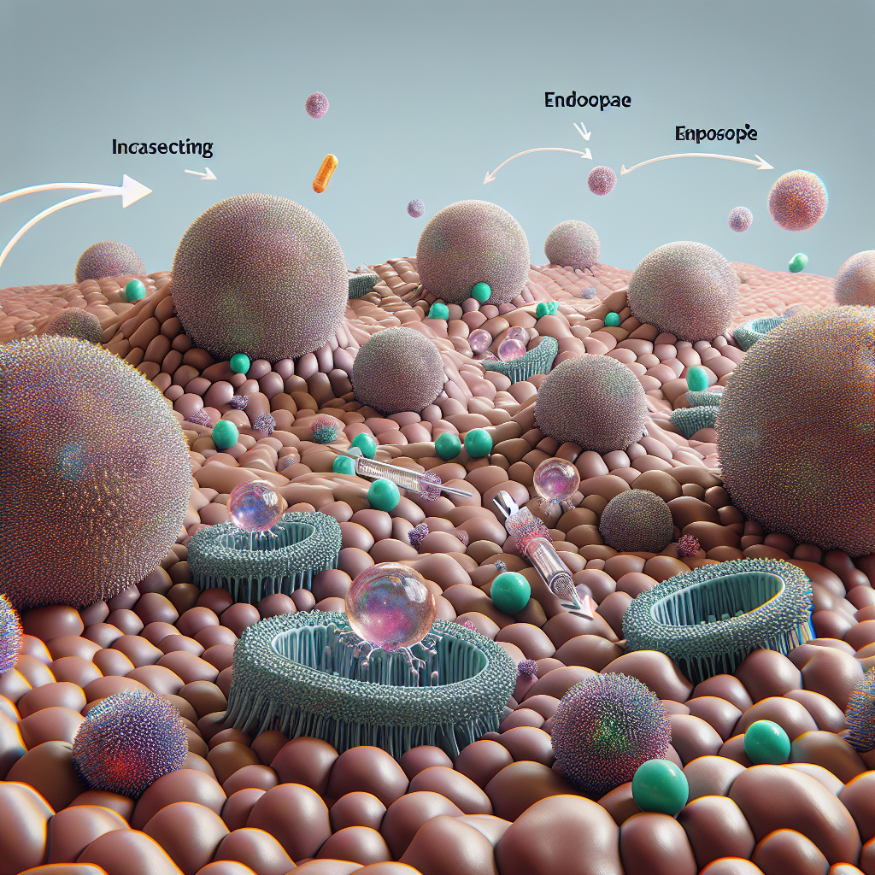
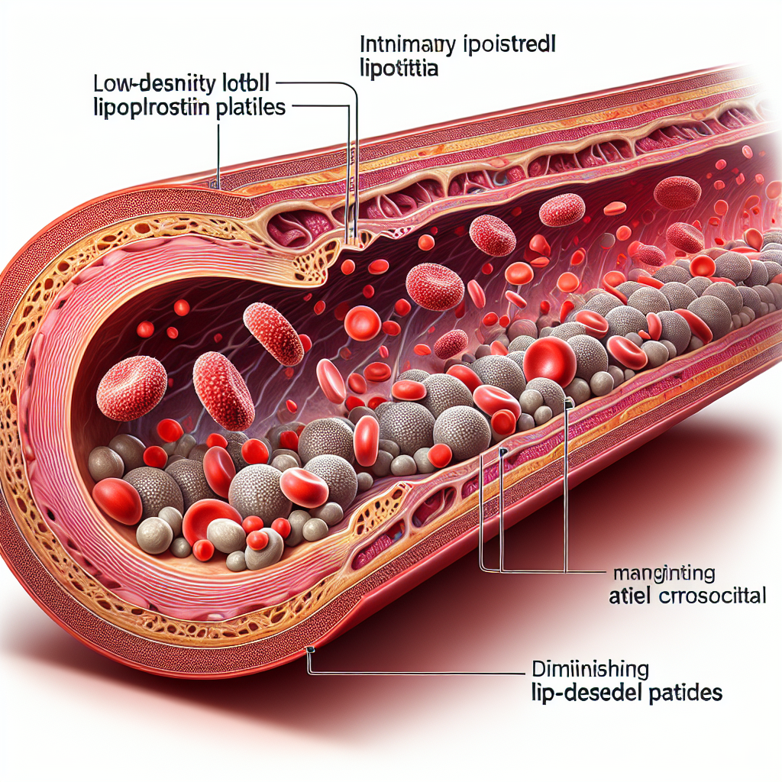
Case Studies & What’s Next
Program: Exagamglogene autotemcel (exa‑cel/CASGEVY)
• Modality: Ex vivo CRISPR/Cas9 RNP; autologous HSPC edit (BCL11A enhancer)
• Indication: Severe sickle cell disease; transfusion‑dependent β‑thalassemia
• Key results: High rates of elimination of severe vaso‑occlusive crises (SCD); Durable HbF induction; transfusion independence in many TDT patients
• Notes: Requires myeloablation and specialized manufacturing/logistics
Program: NTLA‑2001
• Modality: In vivo CRISPR/Cas9 via LNP (mRNA + gRNA)
• Indication: Hereditary transthyretin amyloidosis (ATTR)
• Key results: Single IV dose achieves dose‑dependent TTR reductions (often >80–90%)
• Notes: Demonstrates systemic in vivo editing feasibility in humans
Program: VERVE‑101
• Modality: In vivo adenine base editor (ABE) via LNP
• Indication: Heterozygous familial hypercholesterolemia (PCSK9)
• Key results: Sustained LDL‑C lowering in early clinical data
• Notes: First clinical base editing program; long‑term durability under observation
Prime editing enters/approaches clinical testing for precise corrections
Targeted LNPs and next‑gen capsids broaden beyond liver (lung, muscle, CNS)
In vivo gene insertion and safe‑harbor strategies for durable replacement
Multiplex editing for off‑the‑shelf cell therapies with logic gating
CRISPRi/a and epigenome editing for reversible gene control
Manufacturing scale‑out, closed systems, and outcomes‑based pricing to expand access

